Slide 1


Resilient Cloud Architecture
A comprehensive guide to building fault-tolerant, low-latency systems with robust disaster recovery capabilities for cloud architects and developers

Slide 2
Agenda
1
2
Fault Tolerance
Latency Optimization
Key components and implementation strategies across cloud platforms
Techniques to minimize response times and improve user experience
3
4
Disaster Recovery
Real-world Architecture
Planning, implementation, and testing methodologies
Practical examples and cross-platform implementation guidelines

Slide 3

Understanding Fault Tolerance
The ability of a system to continue operating properly despite component failures
Critical Characteristics
No single point of failure
Detection of failures
Automatic recovery mechanisms
Isolation of failures
Business Impact
Minimized downtime
Improved customer trust
Protection from revenue loss

Slide 4
Implementing Fault Tolerance in the Cloud
Redundancy
Auto Scaling
Load Balancing
Deploy multiple instances of services across multiple Availability Zones (AZs) to ensure continuous operation when an AZ fails.
Implement Auto Scaling Groups (AWS) or Managed Instance Groups (GCP) to automatically replace failed instances and maintain capacity.
Utilize AWS Elastic Load Balancer or GCP Cloud Load Balancing to distribute traffic and prevent overloading single resources.
Stateless Design
Health Checks
Design application components to be stateless so any instance can handle requests, improving resilience and scalability.
Integrate health monitoring for instances, containers, and endpoints to detect and replace unhealthy components.

Slide 5
Cloud-Specific Fault Tolerance Features
Concept
AWS Implementation
GCP Implementation
Multi-Zone Deployment
Auto Scaling Groups across AZs with Elastic Load Balancer
Regional MIGs across zones with Cloud Load Balancing
Health Checks
ELB and Route 53 health checks for traffic routing
Cloud Load Balancer and Cloud Monitoring health checks
Resilient Services
S3, DynamoDB, Aurora Multi-AZ
Cloud Storage, Firestore, Cloud Spanner
Message Queues
Amazon SQS for component decoupling
Cloud Pub/Sub for async messaging
Each cloud provider offers native services designed for high availability, but implementation approaches vary between platforms.

Slide 6
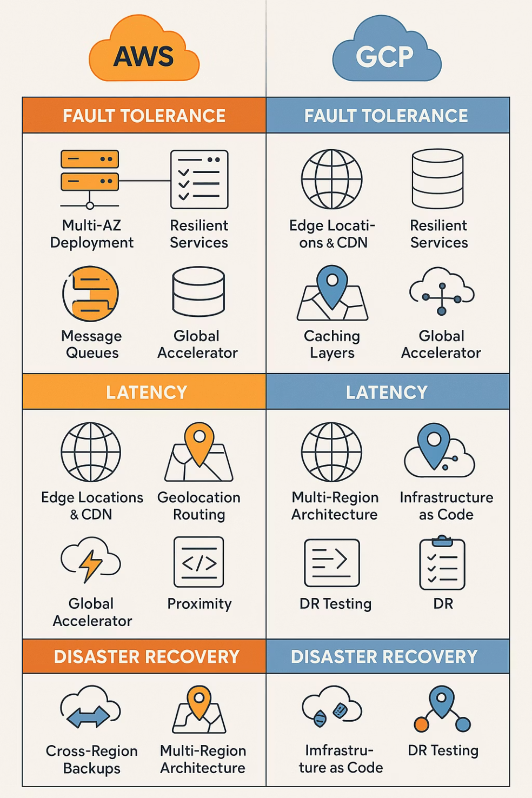
Comparing these strategies for AWS and GCP

Slide 7

Understanding Latency
The time delay between a request and response in a system—critical for user experience
Latency Factors
Physical distance between user and resources
Network congestion and routing efficiency
Server processing time
Data size and transfer protocols
Impact of High Latency
Poor user experience
Increased bounce rates
Reduced conversion rates
Lower search engine rankings

Slide 8




Latency Optimization Strategies
Edge Locations & CDNs
Geo-Distributed Deployments
Deploy content closer to users with Amazon CloudFront or Google Cloud CDN to minimize physical distance traversal.
Host application servers in regions closer to end-users using Route 53 latency-based routing or GCP's geo-based routing.
Optimized Network Paths
Caching Layers
Utilize private links, VPC peering, direct connect options, and premium tier networking to reduce hops and improve performance.
Implement in-memory caches like Redis (ElastiCache or Memorystore) for frequently accessed data to reduce database load.

Slide 9
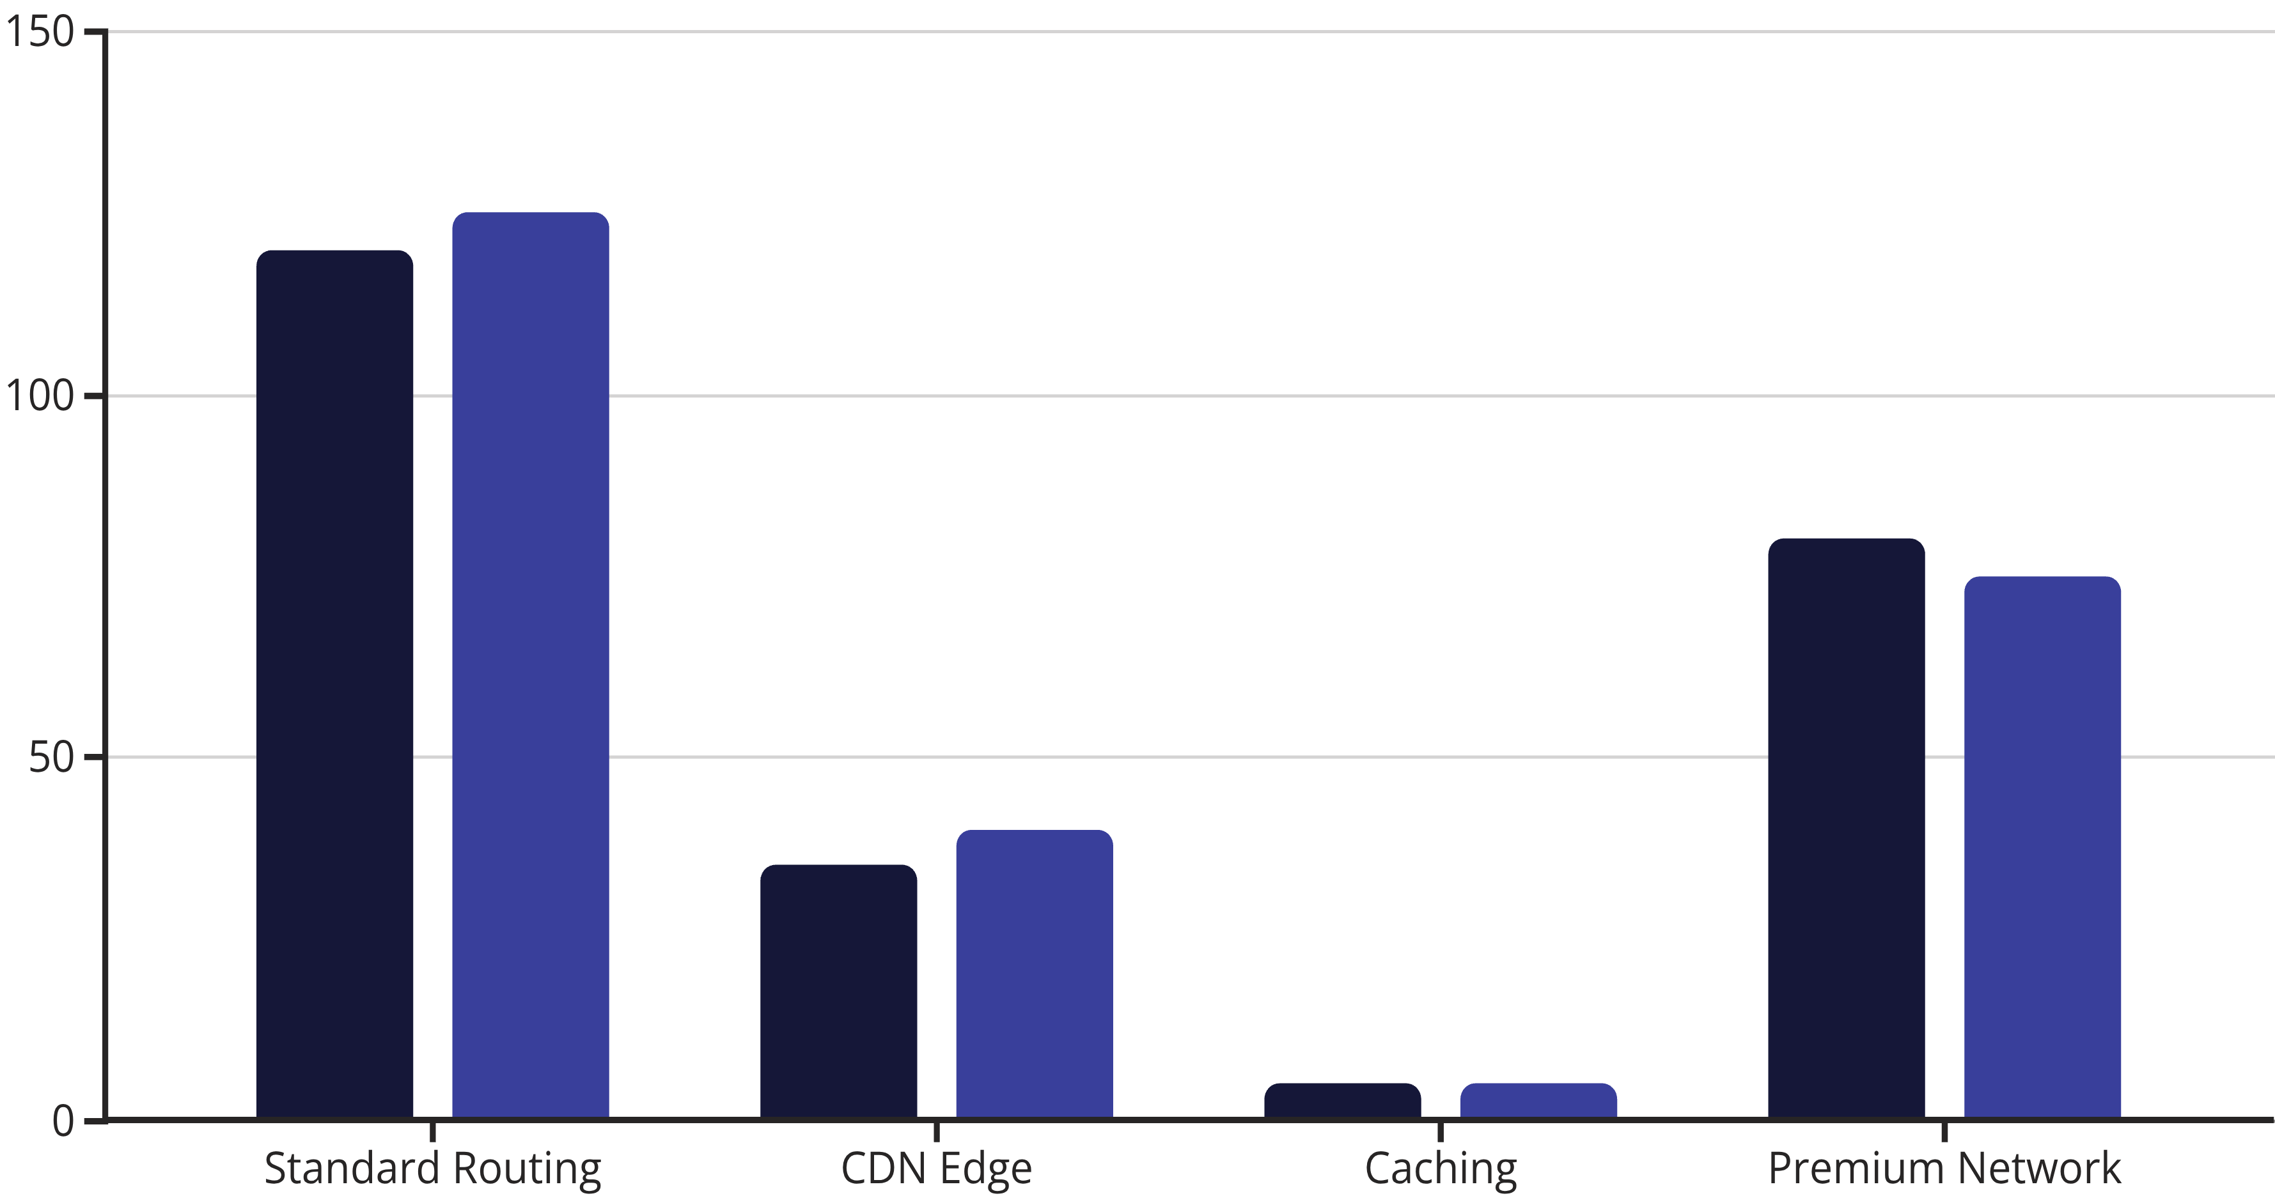
Cloud-Specific Latency Features
AWS Response Time (ms)
GCP Response Time (ms)
Both AWS and GCP offer comparable performance features, with specialized services like AWS Global Accelerator and GCP Premium Tier Network providing optimized global routing paths.

Slide 10

Understanding Disaster Recovery
The process of restoring systems and data after catastrophic failures like region-wide outages
Key Metrics
RTO (Recovery Time Objective): Maximum acceptable downtime
RPO (Recovery Point Objective): Maximum acceptable data loss
Common Threats
Region-wide outages
Data corruption
Accidental deletions
Security breaches
Natural disasters

Slide 11




Disaster Recovery Strategies
Backup & Restore
1
Highest RPO/RTO, lowest cost
Pilot Light
2
Core services ready, but inactive
Warm Standby
3
Scaled-down version ready
Active-Active
4
Full redundancy, lowest RPO/RTO
As you move up the pyramid, costs increase but recovery time and data loss decrease. Each organization must balance business requirements with budget constraints.

Slide 12
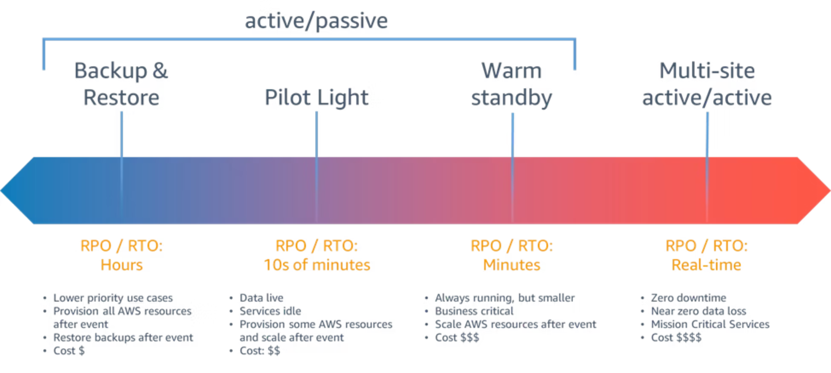
Disaster recovery strategies

Slide 13




Implementing Disaster Recovery in the Cloud
Multi-Region Backups
Infrastructure as Code
Implement regular backups across different regions using Amazon S3 cross-region replication, RDS snapshots, or GCP Cloud Storage dual-region capabilities.
Use CloudFormation, Terraform, or Deployment Manager to quickly re-provision infrastructure in a new region following a disaster.
Failover Architecture
Regular DR Drills
Design active-passive or active-active architectures across regions with Route 53 or Cloud DNS for automated traffic redirection.
Test and validate disaster recovery plans through simulations and failover testing to ensure procedures work as expected.

Slide 14
Cloud-Specific DR Features
Concept
AWS Implementation
GCP Implementation
Cross-Region Backups
S3 cross-region replication, RDS snapshots, AWS Backup
Cloud Storage Dual-Region, Cloud SQL backups
Multi-Region Architecture
Active-Active or Active-Passive via Route 53
Multi-region GKE, Spanner, Cloud DNS + LB
Infrastructure as Code
CloudFormation or Terraform
Deployment Manager or Terraform
DR Testing
Route 53 traffic policies, backup restore tests
Cloud Monitoring, failover testing
Both platforms offer mature DR capabilities but require careful planning and regular testing to ensure effectiveness.

Slide 15
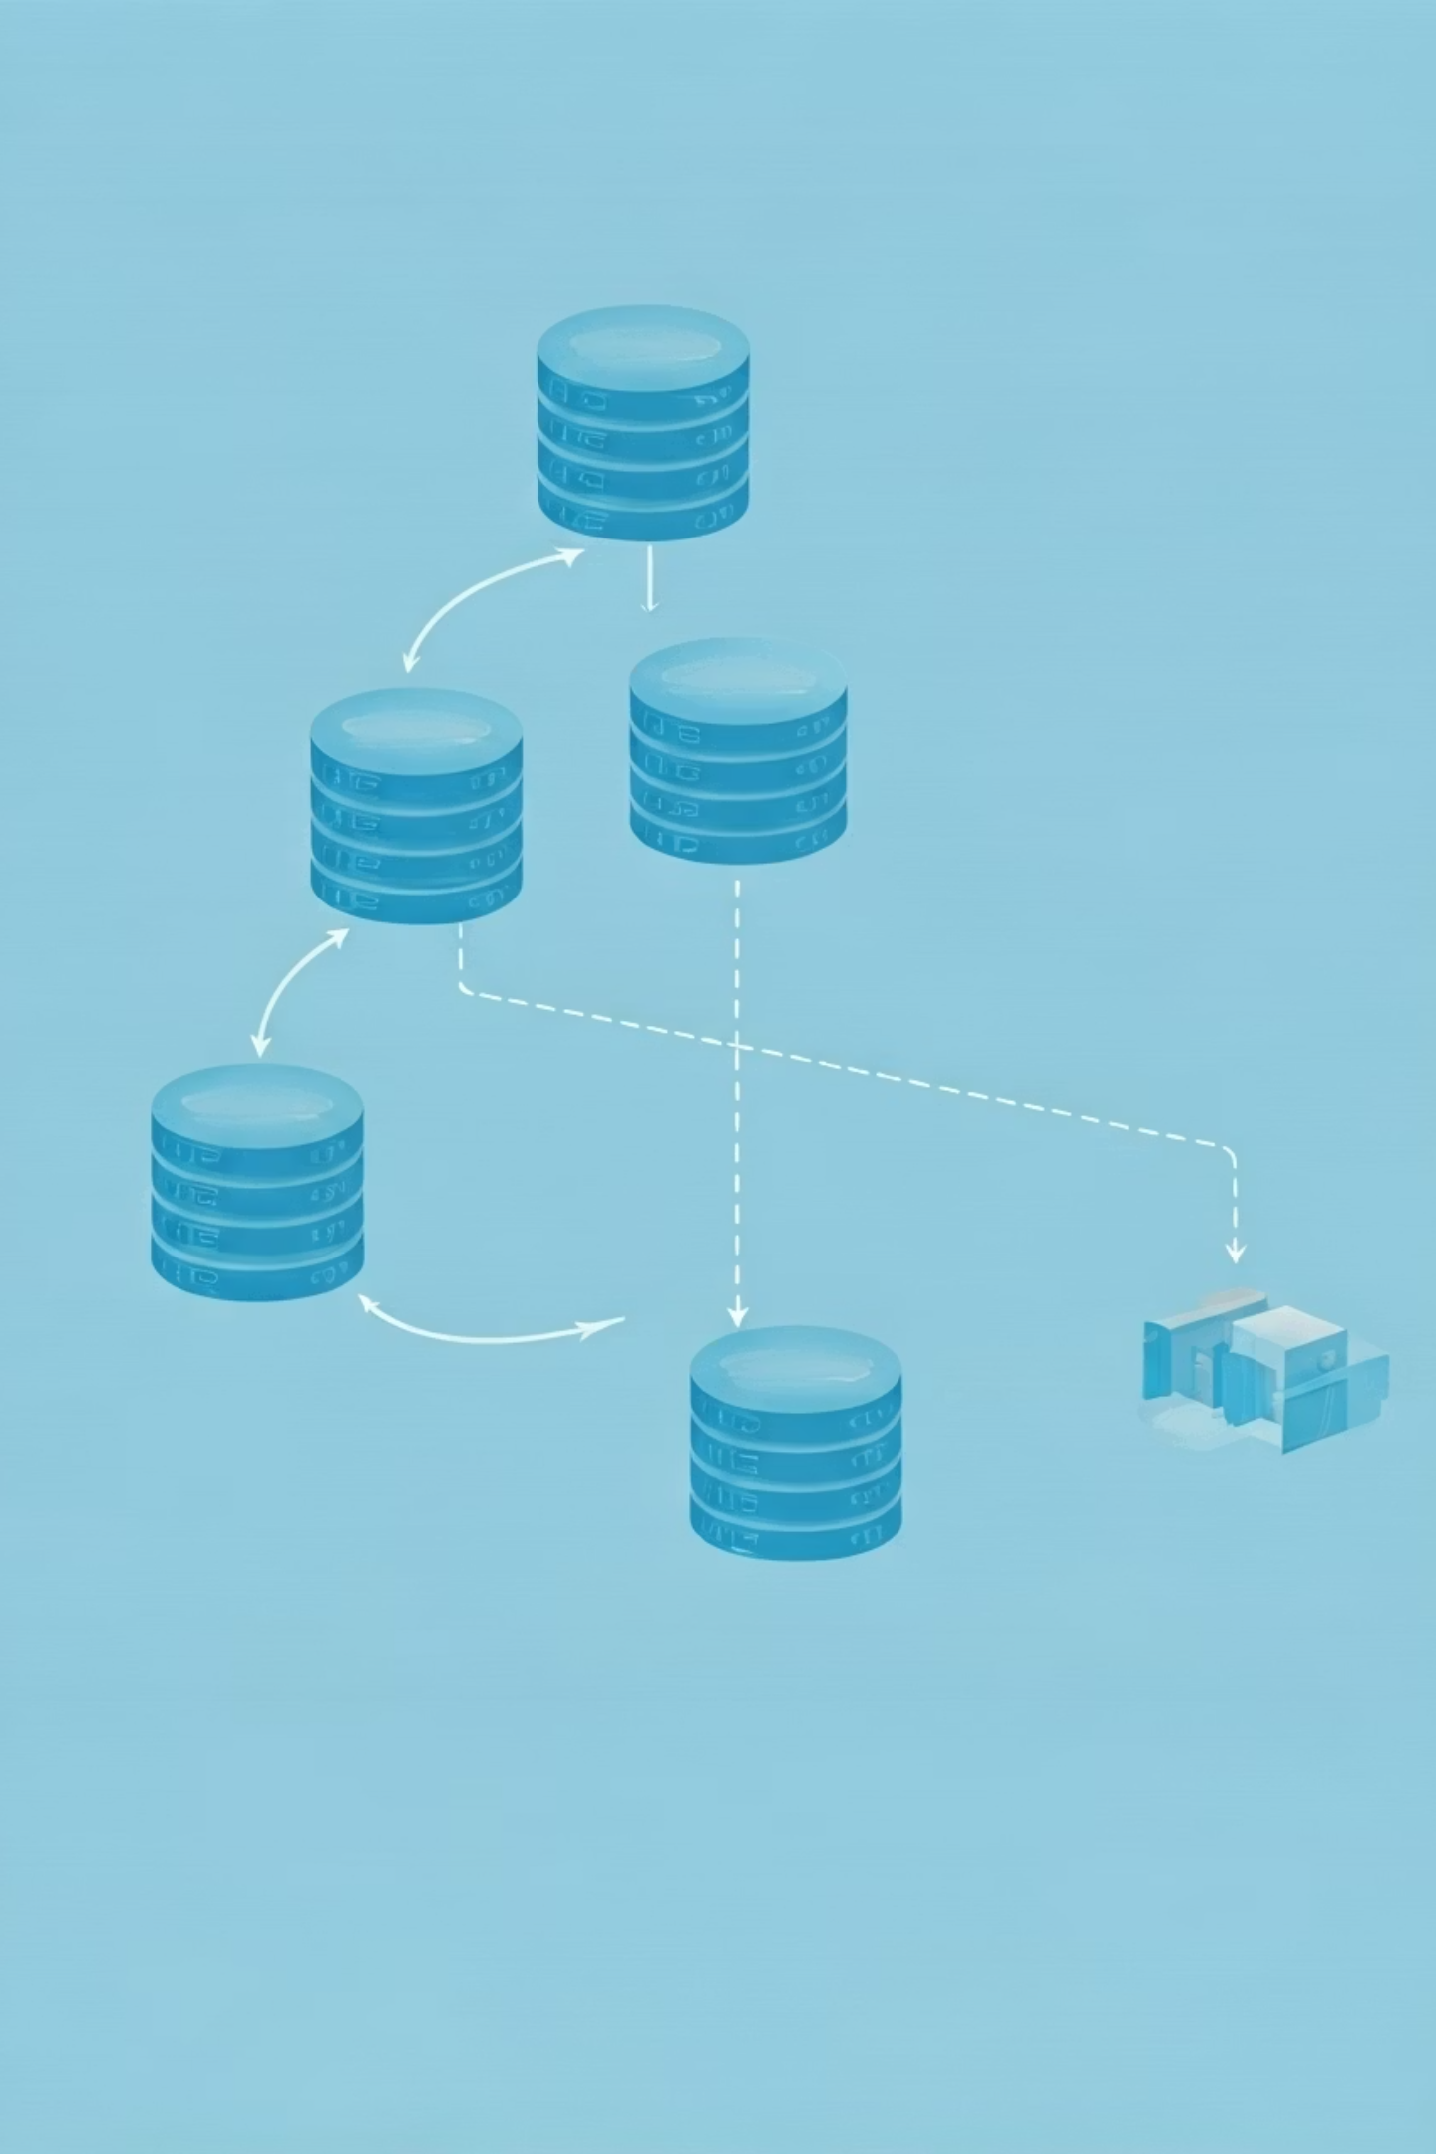
E-commerce Application: Real-world Example
99.99%
<200ms
15min
Availability Target
Global Latency
RTO
Less than 53 minutes of downtime per year
Maximum response time for primary operations
Recovery time objective for regional failure
5min
RPO
Recovery point objective for data loss

Slide 16
Cross-Component Design Matrix
Component
Fault Tolerance
Latency Design
Disaster Recovery
Web Layer
Auto Scaling + Load Balancer
Edge CDN (CloudFront/Cloud CDN)
Deploy in multiple regions
App Layer
Multi-AZ/Zone instances
Geo-proximity routing
Replicate in secondary region
Database
Multi-AZ/Region deployment
Read replicas near users
Cross-region snapshots/replication
Static Content
Highly durable object storage
Global CDN caching
Cross-region replication
Background Jobs
Queue-based processing
Parallel execution
Retry logic in new region
A comprehensive approach requires addressing all three pillars across each application component.

Slide 17










Key Takeaways
Balance Costs
Integrated Approach
Select appropriate resilience levels based on business requirements, as higher availability comes with exponentially increasing costs.
Design fault tolerance, latency optimization, and disaster recovery as interconnected aspects of resilient architecture.
Leverage Cloud Tools
Utilize cloud-native services that provide built-in resilience rather than building custom solutions.
Document Everything
Maintain comprehensive runbooks and documentation for recovery procedures that can be followed during high-stress incidents.
Test Regularly
Conduct chaos engineering and disaster recovery drills to validate system resilience under real-world conditions.

